Slide 1
THREAD IN JAVA

Slide 2
WHAT IS A JAVA THREAD?
Lightweight process.
Built-in support for multithreaded programming.
Two or more parts that can run concurrently
Each thread defines a separate path of execution

Slide 3
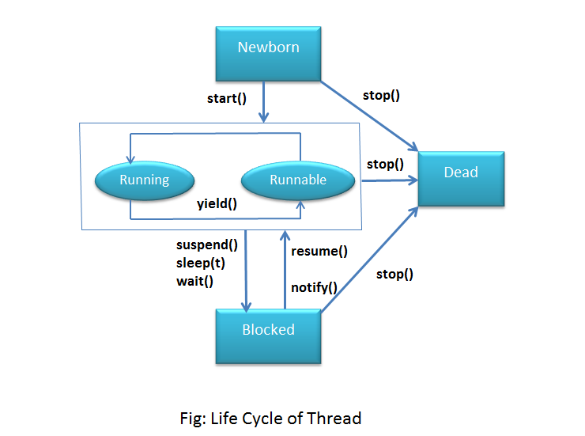
THREAD LIFE CYCLE

Slide 4
New – When we create an instance of Thread class, a thread is in a new state.
Runnable – The Java thread is in running state.
Suspended – A running thread can be suspended, which temporarily suspends its activity. A suspended thread can then be resumed, allowing it to pick up where it left off.
Blocked – A java thread can be blocked when waiting for a resource.
Terminated – A thread can be terminated, which halts its execution immediately at any given time. Once a thread is terminated, it cannot be resumed.

Slide 5
TO CREATE A NEW THREAD
Extend Thread Class
Implement the Runnable interface.

Slide 6
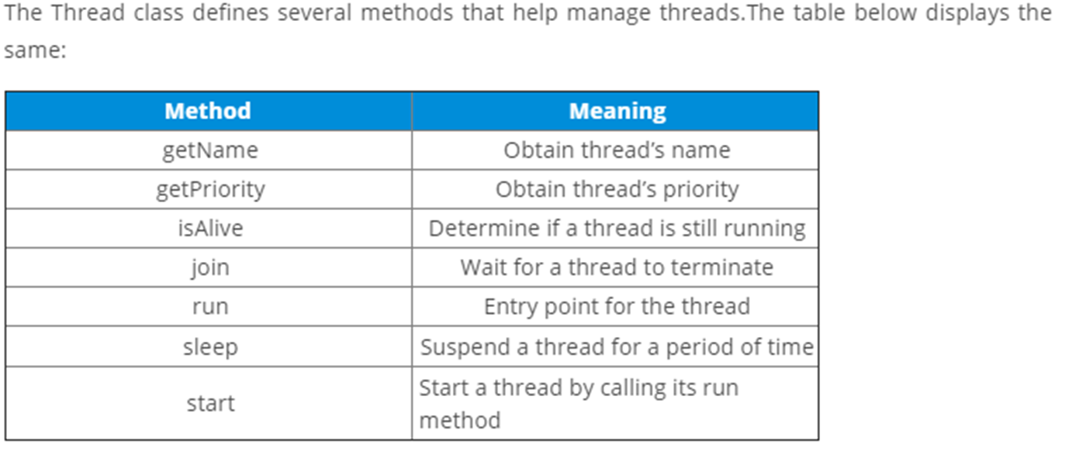

Slide 7
THREAD PRIORITY
Priority for a thread is in range of 1 to 10. There are 3 static variables defined in thread class for priority.
Public static int min_priority: this is minimum priority that a thread can have. Value for this is 1.

Slide 8
public static int NORM_PRIORITY: This is default priority of a thread if do not explicitly define it. Value for this is 5.
public static int MAX_PRIORITY: This is maximum priority of a thread. Value for this is 10

